Slide 1
Becoming a Software Developer
Dianna Tingg

Slide 2
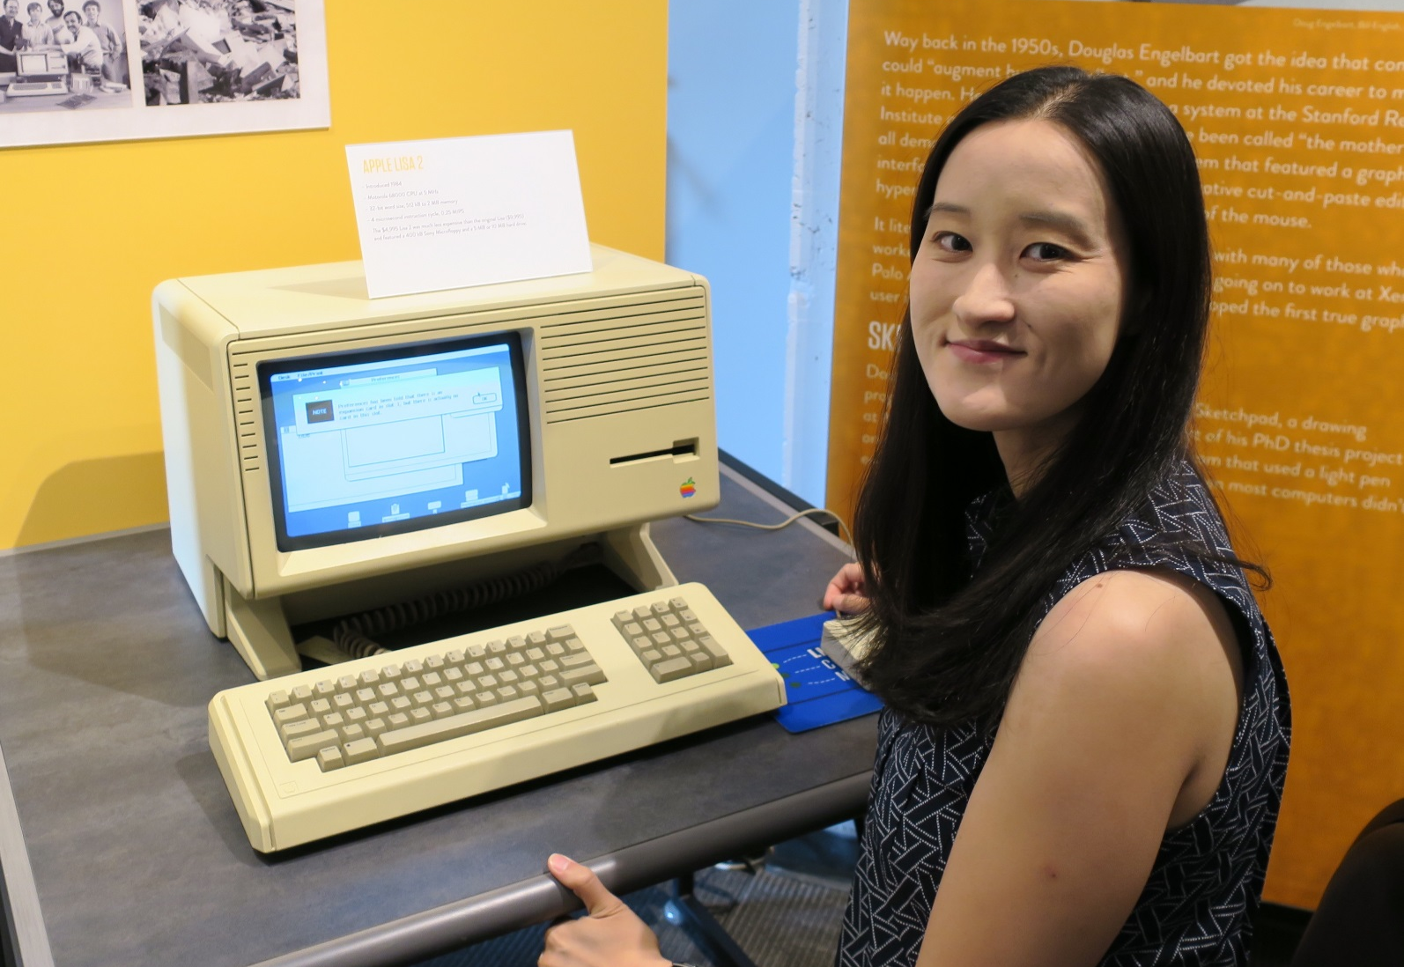
Living Computers: Museum + Labs
2245 First Ave S (SoDo)

Slide 3

UW Professional & Continuing Education
Downtown Seattle, Bellevue, Bothell
Classes in-person or online
Certificate in Python Programming
Costs covered by tuition reimbursement
https://www.pce.uw.edu/

Slide 4
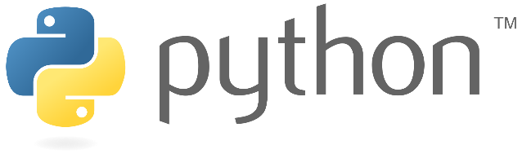
Created by Guido van Rossum in 1991
Named after the British comedy group Monty Python
High-level, general-purpose programming language
Google, YouTube, Reddit, Instagram, Spotify
Good for data science and machine learning

Slide 5
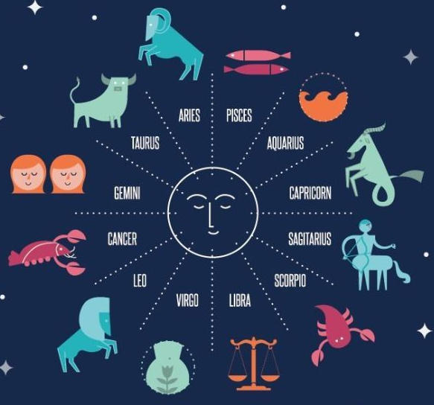
Horoscope Program
The Seattle Times Horoscopes:
https://www.seattletimes.com/horoscopes/

Slide 6
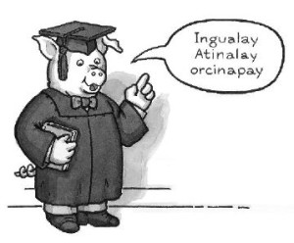
Pig Latin Mashup
Random fact generator:
http://unkno.com/
Pig Latin translator:
http://hidden-journey-62459.herokuapp.com/
Dianna’s mashup:
http://piglatinfact.herokuapp.com/

Slide 7
Raspberry Pi Project

Slide 8
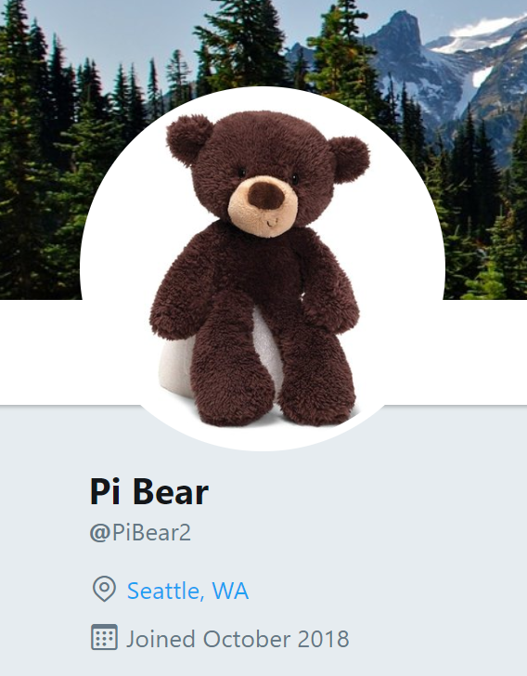
twitter.com/PiBear2

Slide 9
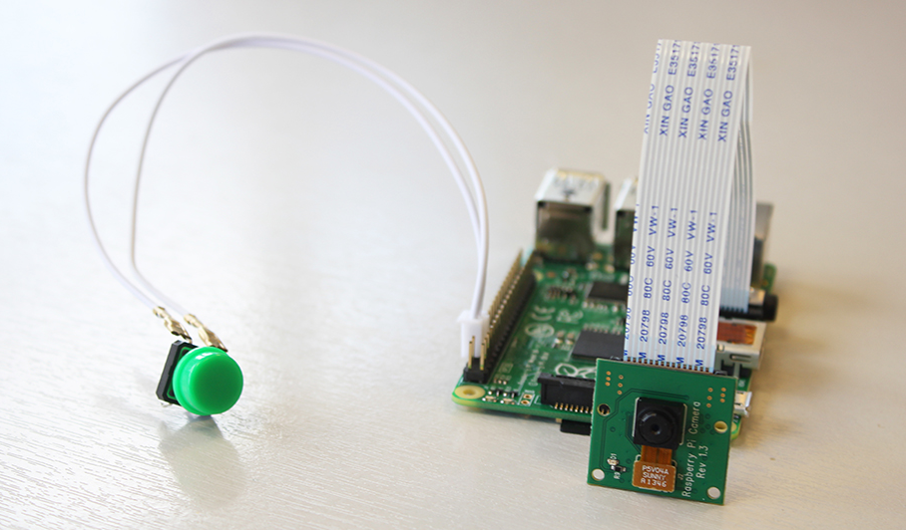

Slide 10
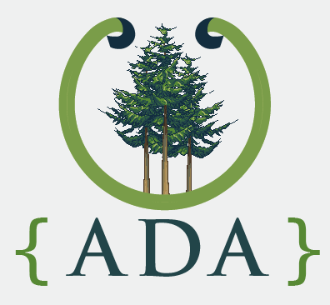
Ada Developers Academy
Non-profit training program in Downtown Seattle
For women and gender-diverse people
6 months of full-time classroom training
5 months in an industry internship
Sponsor companies: Google, Amazon, Nordstrom, Indeed
Resume, essays, Excel challenge, coding challenge, interview

Slide 11
Chocolate Factory Program
Must be written in Ruby
Factory is open 3 days a week
Milk chocolate bars cost $2 to produce and are sold for $3
Dark chocolate bars cost $3 to produce and are sold for $5
Accepts input from the user
Calculate various metrics

Slide 12
Conclusion

